Slide 1
Variant comparison and detection of de novo variants
Genome Informatics 2021
Authors:
Milica Lazić 3203/20
Pavle Milenković 3016/20
Mentors:
Nevena Nikolić
Vladimir Kovačević

Slide 2
Summary
Assignment description
Whole genome sequencing (WGS)
Variant Calling
GRAF Germline Variant Detection Workflow
Variant comparison algorithm
RTG Tools vcfeval analysis
Results
Conclusion
References

Slide 3
Assignment description
Reconstruct 3 sample genomes using GRAF workflow
Develop a tool in Python programming language that calculates the number and percentage of de novo variants in the child genome, by overlapping 2 VCF files
Perform the same calculation using the vcfeval tool from the RTG Tools
Compare the results of the 2 algorithms, identify the specific differences and discuss the reasons of their occurence
Notes:
Objašnejnje šta je de novo

Slide 4

Whole genome sequencing (WGS)
The process of determining the order of the four chemical building blocks - called "bases" - that make up the DNA molecule
Some of the applications of WGS include:
Determining the frequency of mutations
Diagnostic use
Population genomics
Family Disease Pedigrees
Rare tumor types studies
Drug trials and pharmacogenomics

Slide 5
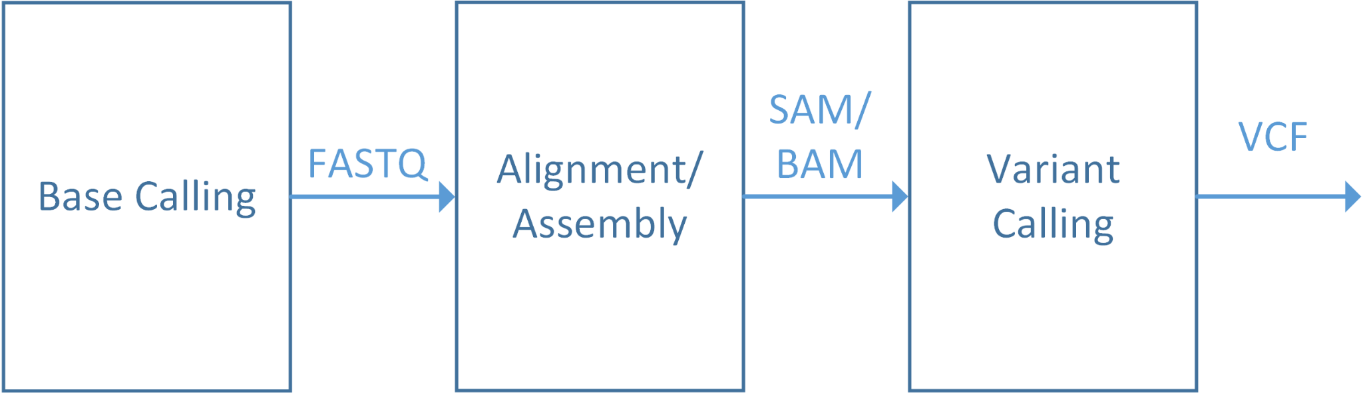
Whole genome sequencing (WGS)

Slide 6
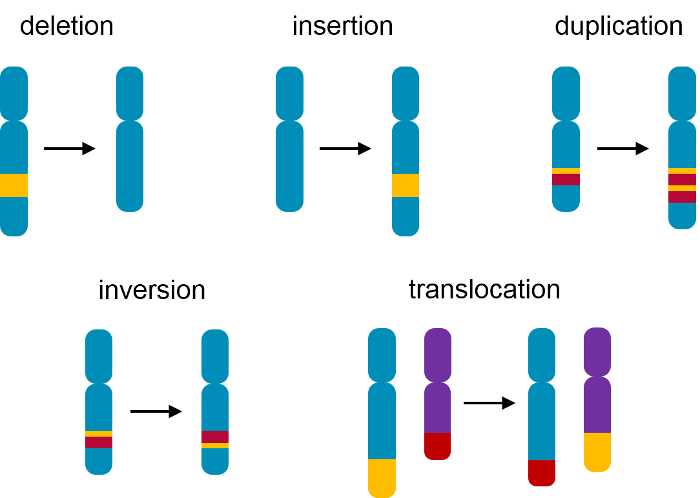
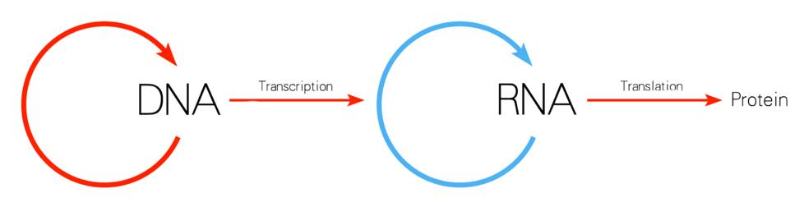
Variant calling
Identifying the variants from the sequenced data
The data is stored inside a VCF file
Depending on the location and the type of the variant, we can predict the impact of the mutation.

Slide 7
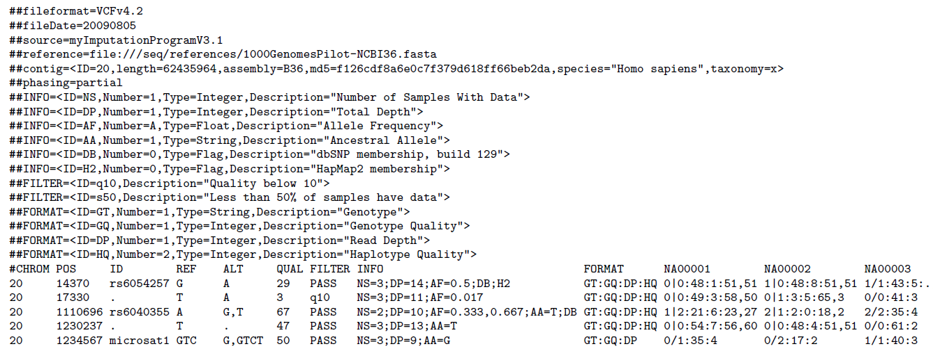
Variant calling
The variant calling data is stored inside a VCF (Variant Call Format) file
VCF file contains:
Meta-information lines
Header line
#CHROM
POS
ID
REF
ALT
QUAL
FILTER
INFO
Data lines
Notes:
reći kako je sortiran VCF fajl

Slide 8
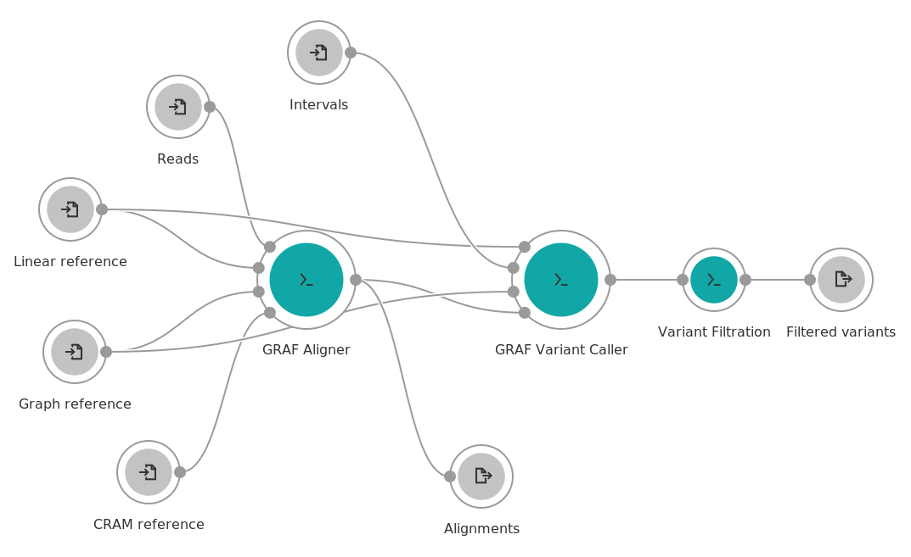
GRAF Germline Variant Detection Workflow
Instead of the linear representation of the human genome, the graph reference includes additional information on the genetic diversity
Notes:
Opis inputs i outputs

Slide 9
GRAF Germline Variant Detection Workflow
Instead of the linear representation of the human genome, the graph reference includes additional information on the genetic diversity
Notes:
Opis inputs i outputs

Slide 10
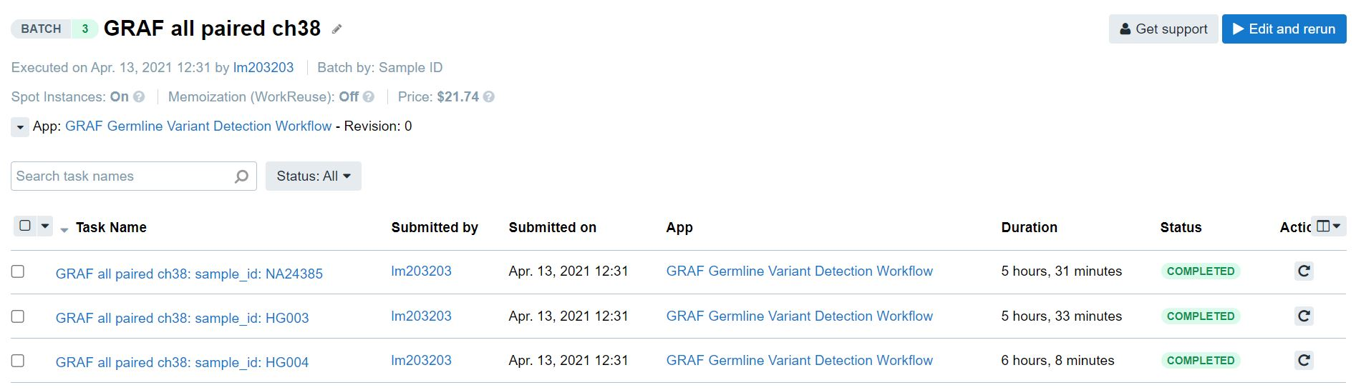
GRAF Germline Variant Detection Workflow
Input files include three available Genome In A Bottle (GIAB) samples of AshkenazimTrio - paired-end reads of both parents and a child
Linear reference, graph reference and intervals inputs use version 38 of human genome assembly
Separate analyses are needed for each sample, so they were run as a batch task on the CGC platform
Notes:
Opis inputs i outpu

Slide 11
Variant comparison algorithm
Algorithm developed in Jupyter Notebook using Python 3.8
Jupyter Notebook was run as an interactive analysis on the CGC platform
PyVCF library used for parsing VCF files
Reading and writing VCF files
Iterating through records
Ease of access to individual record fields
Additional support for filtering

Slide 12
Variant comparison algorithm
Keywords:
Baseline VCF file - a reference
Call VCF file - a file compared against the baseline in order to identify de novo variants
Record - one data line from a VCF file
The basis of the algorithm relies on going through both baseline and call VCF file lineary in parallel
The main loop iterates through every record inside the given call VCF file
The current record within the baseline VCF file is advanced based on conditions within the main loop

Slide 13
Variant comparison algorithm
Keywords:
Baseline VCF file - a reference
Call VCF file - a file compared against the baseline in order to identify de novo variants
Record - one data line from a VCF file
The basis of the algorithm relies on going through both baseline and call VCF file lineary in parallel
The main loop iterates through every record inside the given call VCF file
The current record within the baseline VCF file is advanced based on conditions within the main loop

Slide 14
Variant comparison algorithm
Comparisons are done based on the position field of the records (record.POS)
If the positions match, the records are compared:
Do REF and ALT fields match in accordance with genotypes?
If the call position is ahead of the baseline position:
Advance the baseline position until it reaches (or surpasses) the call position
If the baseline position is ahead of the call position:
The call record observed has no match → it is a de novo variant

Slide 15
Variant comparison algorithm
The described method works while the observed records are on the same chromosome
This condition is evaluated in the main loop:
Same chromosome → described comparison
Different chromosome:
Call position is ahead of the baseline position → advance the baseline position until the chromosome matches
Baseline position is ahead of the call position → this call record is a de novo variant (and all further call records within that chromosome)

Slide 16
Variant comparison algorithm
We call the main function to compare the child VCF file against one parent VCF file
Every de novo variant found is recorded in the output file
This output file is then compared against the other parent VCF file
The result is the file containing unique variants present in the child genome
In the end, we calculate the number of de novo variants and their percentage from the total number of variants in the child genome

Slide 17
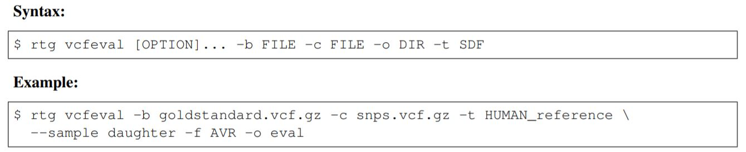
RTG Tools vcfeval analysis
State of the art tool for the comparison of VCF files
Performs variant comparison at the haplotype level
Notes:
Explain inputs
Bgzip and index VCF files

Slide 18
RTG Tools vcfeval analysis
State of the art tool for the comparison of VCF files
Performs variant comparison at the haplotype level
Notes:
Explain inputs
Bgzip and index VCF files

Slide 19
Results
 | Our algorithm | vcfeval
No. of de novo variants | 142685 | 83438
% of de novo variants | 2.9 | 1.7

Slide 20
Conclusion
RTG Tools uses a novel dynamic programming algorithm
Deals with complex variant representation
Our algorithm didn’t take into account these complexities
Any future improvements to our algorithm have to cover differing representations of the same variant

Slide 21
References
Course materials
The Variant Call Format (VCF) Version 4.2 Specification
RTG Tools Operations Manual
Comparing Variant Call Files for Performance Benchmarking of Next-Generation Sequencing Variant Calling Pipelines. Cleary at al. bioRxiv, 2015. doi: https://doi.org/10.1101/023754
Pre-formatted Metagenomic and Human reference datasets
PyVCF - A Variant Call Format Parser for Python — PyVCF 0.6.8 documentation
GRAF Germline Variant Detection Workflow
Notes:
Dodati rad za vcfeval

Slide 22
Thank you for the attention!

